Slide 1
Photo used with permission of ROW Adventure Center
Idaho Minimum Stream Flow Program Coeur d’Alene/Spokane Basin October 28, 2015

Slide 2
Minimum Stream Flow
Established in 1978 (Idaho Code Title 42, Chapter 15)
Definition: Flow or volume required to protect the fish and wildlife habitat, aquatic life, recreation, aesthetic beauty, navigation, transportation, or water quality of a stream.
Held by the Idaho Water Resource Board in the public interest.
Criteria:
Cannot impact any senior water right
Must be necessary to protect instream values
Must be minimum, not optimum
Must be capable of being maintained
Must be in the public, not private interest

Slide 3
Minimum Stream Flow Process
Request for MSF from any entity
Data collection and meeting to determine public interest
Application filed
Public Hearing
Director issues Permit (if approved)
Legislative approval (active or passive)
Proof of beneficial use filed
License issued

Slide 4
Existing MSFs in Basins 91-95

Slide 5
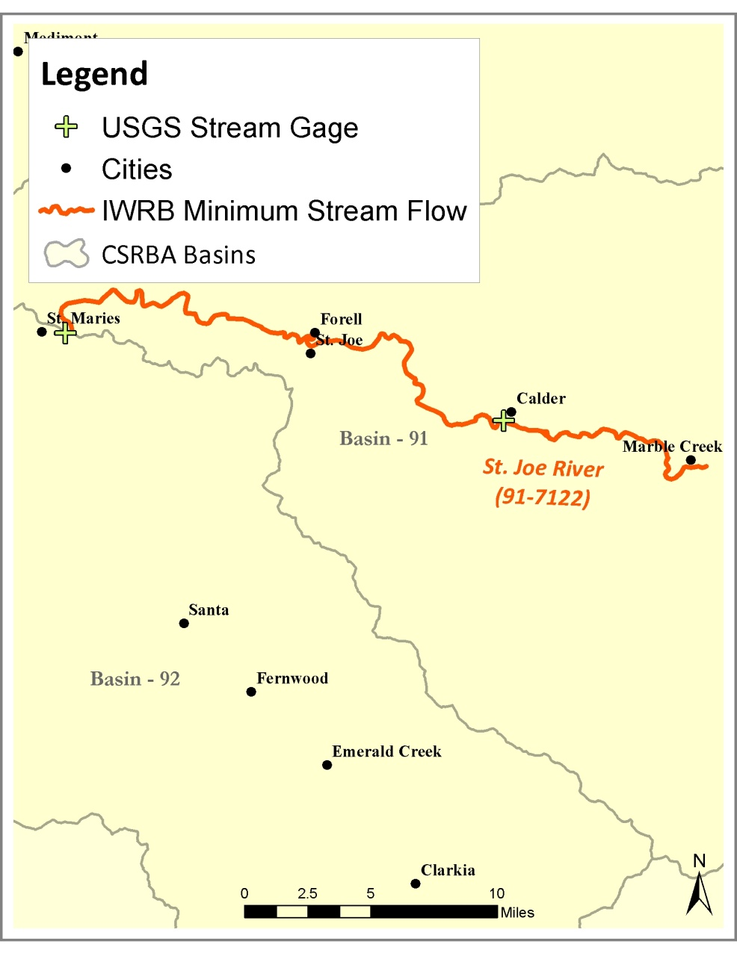
St Joe River 91-7122
Priority Date: June 15, 1992
Flows:
11/1-7/31 941 cfs
8/1-10/31 470 cfs
No subordination provisions
Method: Tennant

Slide 6
Tennant Method
Donald L. Tennant, a fisheries biologist with the US Fish and Wildlife Service, created a methodology to assign percentages of mean annual flow to stream values such as fish and aquatic habitat and riparian health. Stream gage data is the only information needed to utilize this methodology.
Mean Annual Flow
<10% Severely Degraded
10% Poor or Minimum
10-30% Fair or Degrading
20-40% Good
30-50% Excellent
40-60% Outstanding
60-100% Optimum Range
200% Flushing or Maximum
Tennant, D.L. 1976. “Instream flow regimens for fish, wildlife, recreation, and related environmental resources”, in Orsborn, J.F. and Allman, C.H. (Eds), Proceedings of the Symposium and Specialty Conference on Instream Flow Needs II. American Fisheries Society, Bethesda, Maryland. pp.224-234.

Slide 7
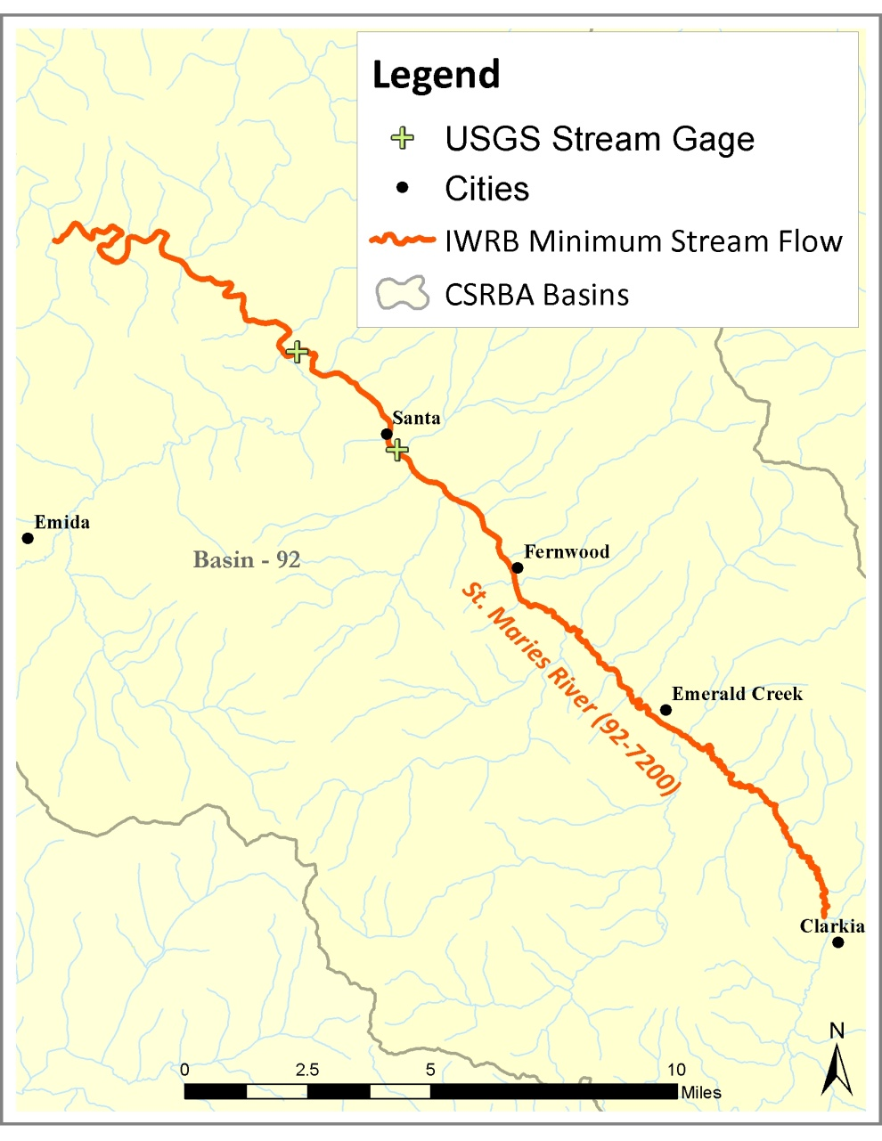
St Maries River 92-7200
Priority Date: June 15, 1992
Flows
12/1-7/31 141 cfs
8/1-11/30 65 cfs
No subordination provisions
Method:Tennant

Slide 8
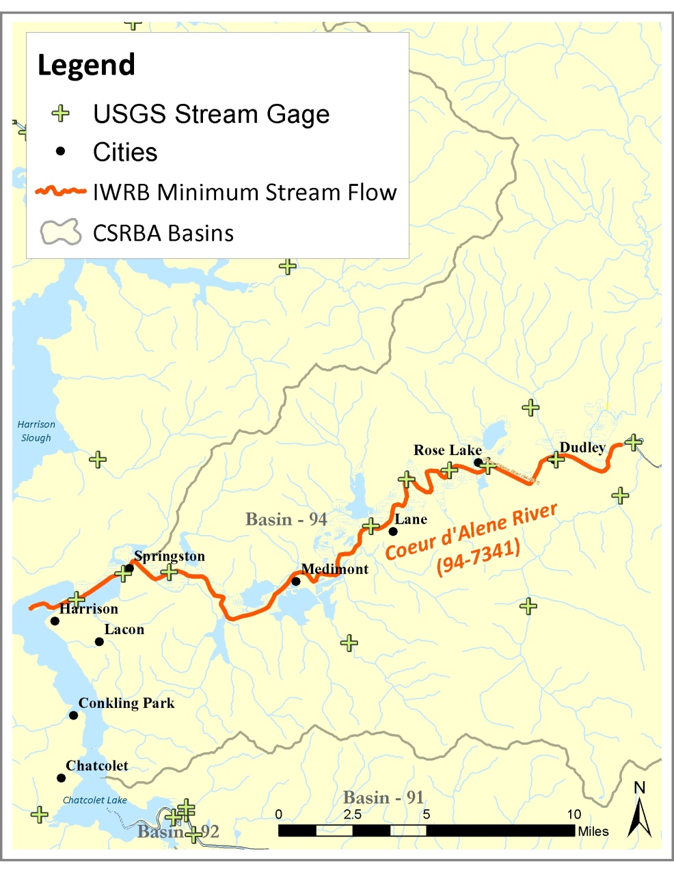
Coeur d’Alene River 94-7341
Priority Date: June 15, 1992
Flows:
11/1-6/30 1,018 cfs
7/1-10/31 413 cfs
Subordinated to future municipal and domestic development from the CdA River and tributaries upstream of MSF reach.
Method: Tennant

Slide 9
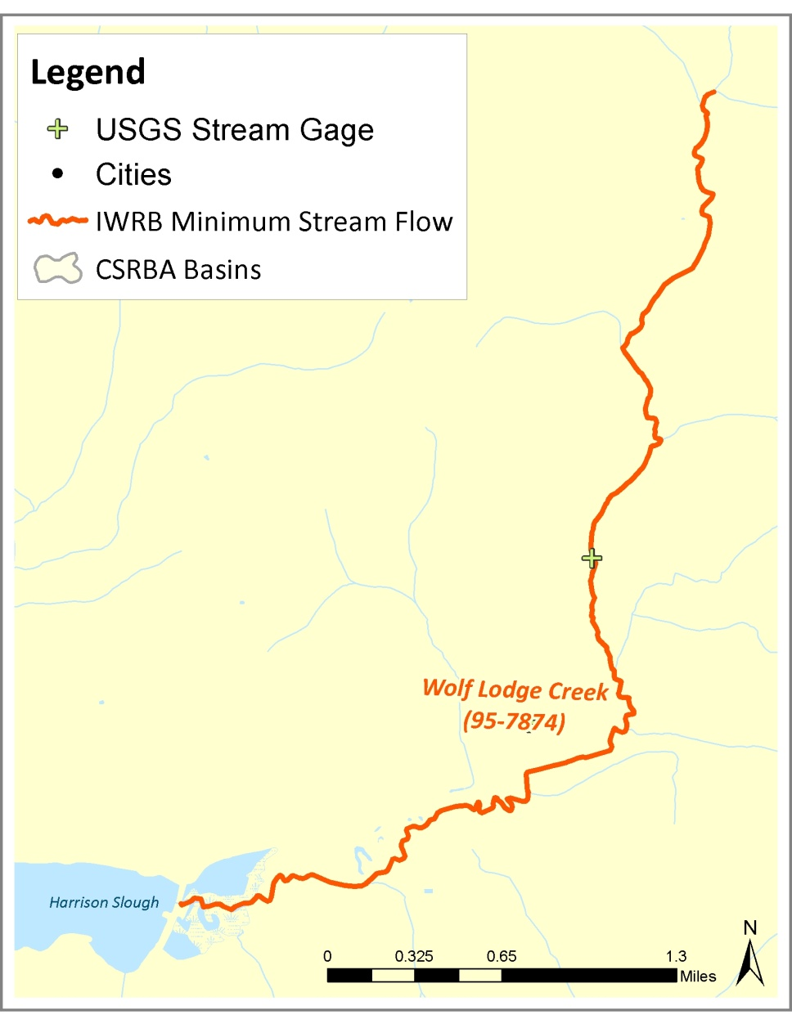
Wolf Lodge Creek 95-7874
Priority Date: September 13, 1978
Flows:
11/6-6/30 30 cfs
7/1-11/15 7 cfs
No subordination provisions
Usable habitat modeled by US Bureau of Reclamation water surface profile program.

Slide 10
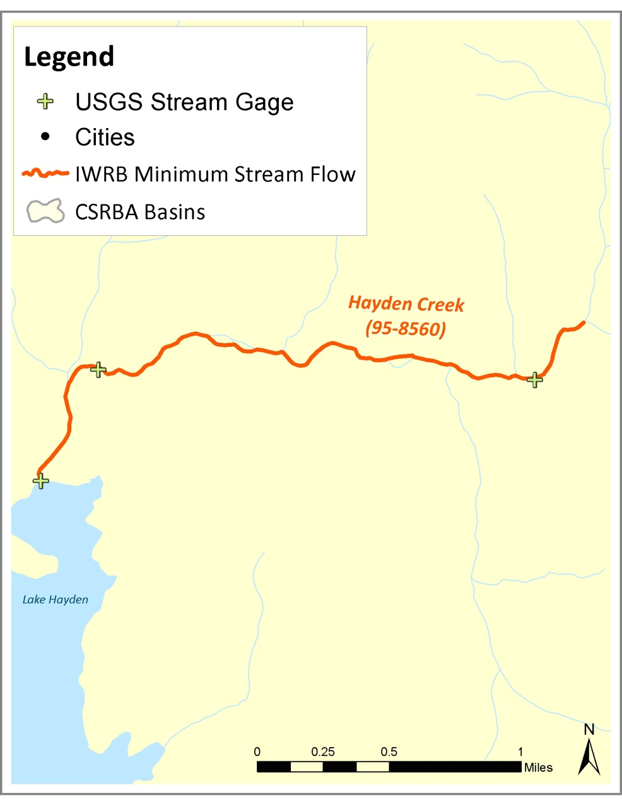
Hayden Creek 95-8560
Priority Date: October 16, 1987
Flows:
7/1 – 2/29 4 cfs
3/1 – 6/30 20 cfs
No subordination provisions
Numerous instream flow methodologies

Slide 11
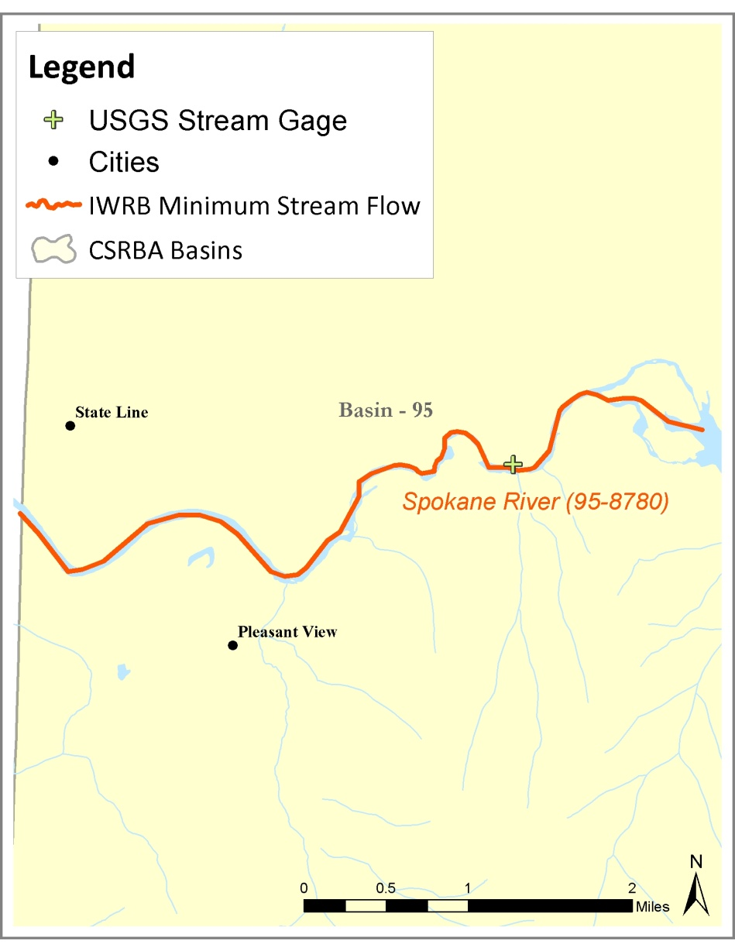
Spokane River 95-8780
Priority Date: June 15, 1992
Flows:
11/1-6/30 2,496 cfs
7/1-10/31 951 cfs
Shall not directly or indirectly cause any change in operation of Post Falls dam.
Subordinate to future municipal and domestic development from the Spokane River and tributaries upstream of MSF reach.
Method: Tennant

